Slide 1





Conclusion
We provide a developed system that introduce the following:
The system collect news from different sources
1

Slide 2
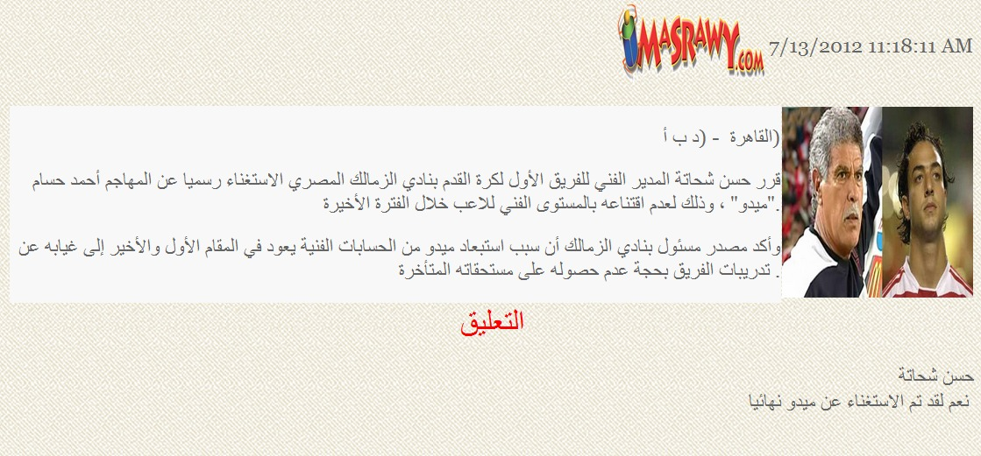
Conclusion
Ensuring confidence.
2

Slide 3

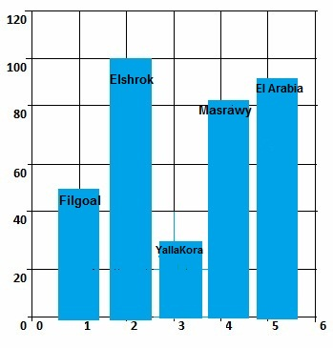
Conclusion
Evaluation
3

Slide 4
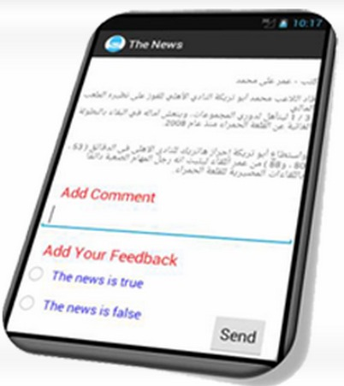
Conclusion
Mobile application
4

Slide 5
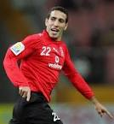
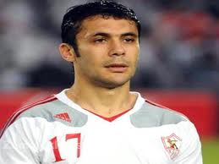
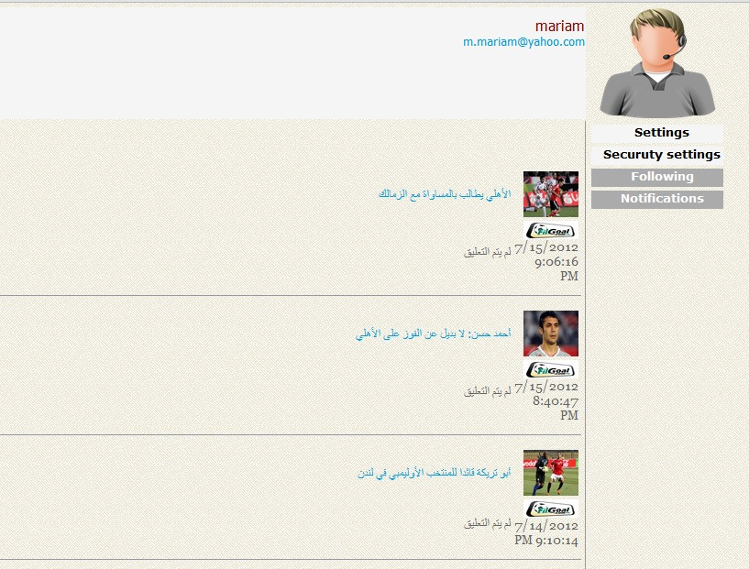
Conclusion
Following up
5

Slide 6
Marketing
Our system obtained:
with ID: 2011/2093
with EFS ID: 12088963, Application Number: 61599445 and Confirmation Number: 3711
We make a business plan and begin to communicate with very important investors : Eng/Tamer Elnhas .
We communicate with important users :President of the ruling Nour Salafi
patent from Egypt
patent from America

Slide 7

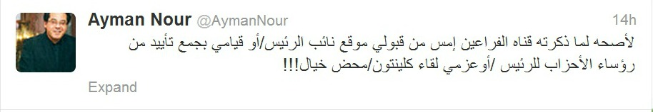
Future Work
Connection with Twitter.
1

Slide 8
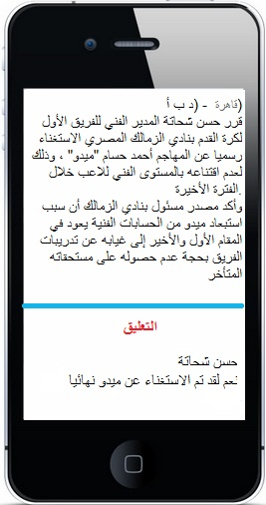
Future Work
Provide mobile application to all users
2

Slide 9
The mobile application will be developed to work in all platforms
Future Work
3
Android
iPhone
Nokia's Symbian
BlackBerry

Slide 10
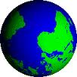
Future Work
Collect global news and connect with them owners
4

Slide 11
Future Work
Data mining will improved using linguistics approach instead of mathematical approach .
5

